Slide 1
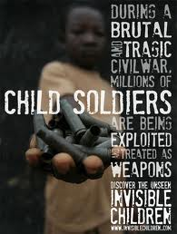
Rochester Summer Institute for Human Rights and Genocide Awareness
Child Soldiers
Presented by Jennifer Wilson
NEHS, USHMM Teacher Fellow

Slide 2
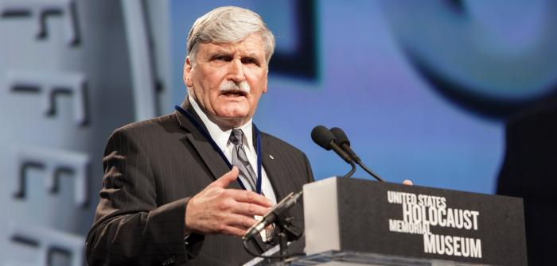
General Romeo Dallaire
http://www.youtube.com/watch?feature=player_detailpage&v=_W9TP3tWmJ4
Lieutenant-General Roméo Dallaire accepts the Museum's 2014 Elie Wiesel Award at the National Tribute Dinner. —US Holocaust Memorial Museum

Slide 3
Genocide and Child Soldiers
How does the use of child soldiers connect with the concept of Genocide as defined by the Genocide convention?

Slide 4
Genocide Convention, Article II:
"In the present Convention, genocide means any of the following acts committed with intent to destroy, in whole or in part, a national, ethnical, racial or religious group, as such:
(a) Killing members of the group;
(b) Causing serious bodily or mental harm to members of the group;
(c) Deliberately inflicting on the group conditions of life calculated to bring about its physical destruction in whole or in part;
(d) Imposing measures intended to prevent births within the group;
(e) Forcibly transferring children of the group to another group. "

Slide 5
Human Rights
It is also a matter of human rights…
The United Nations has the Universal Declaration of Human Rights created in 1948.
In addition, in 1989, a Convention on the Rights of the Child was held in New York.
“The Convention is the first legally binding international treaty to give universally-recognized norms and standards for the protection and promotion of children's rights in a single text.”
http://www.un.org/Pubs/CyberSchoolBus/treaties/child.asp

Slide 6
Human Rights continued…
In addition, in 2000, an “optional protocol” was added:
“Objectives
The objective of the Optional Protocol is to limit the use of children in armed conflict. It particularly aims to raise the minimum age for recruitment and actual participation in hostilities to 18.
Key Provisions
This Protocol prohibits governments and other groups from recruiting people under 18 years of age. It requires that countries raise the minimum recruiting age above the age set by the Convention on the Rights of the Child, do everything possible to keep people under the age of 18 from direct participation in hostilities, take precautions against the voluntary recruitment of people under the age of 18, and report to the Committee on the Rights of the Child on their compliance with the provisions of the Convention and the Protocol.”
Source: http://www.un.org/Pubs/CyberSchoolBus/treaties/armed.asp

Slide 7
Definition of a Child Soldier:
A child associated with an armed force or armed group refers to any person below 18 years of age who is, or who has been, recruited or used by an armed force or armed group in any capacity, including but not limited to children, boys and girls, used as fighters, cooks, porters, spies or for sexual purposes.
(Source: Paris Principles on the Involvement of Children in Armed Conflict 2007)
Found in: http://childrenandarmedconflict.un.org/effects-of-conflict/six-grave-violations/child-soldiers/

Slide 8
“Recruiting and using children under the age of 15 as soldiers is prohibited under international humanitarian law – treaty and custom – and is defined as a war crime by the International Criminal Court.”
http://childrenandarmedconflict.un.org/effects-of-conflict/six-grave-violations/child-soldiers/

Slide 9
The Holocaust and Hitler Jugend
During a visit to the Hochland youth camp, Reichsfuehrer-SS Heinrich Himmler (center) and camp leader Emil Klein (right, in profile) review a group of German youth who are standing in formation. Photograph # 60450, USHMM

Slide 10
Hitler Youth gather on a street in Germany. [This image from Berlin was found in the P-20-1939 contact book]
Photograph # 47389, USHMM,
Julien Bryan

Slide 11
“Indoctrinating Youth”
“These boys and girls enter our organizations [at] ten years of age, and often for the first time get a little fresh air; after four years of the Young Folk they go on to the Hitler Youth, where we have them for another four years . . . And even if they are still not complete National Socialists, they go to Labor Service and are smoothed out there for another six, seven months . . . And whatever class consciousness or social status might still be left . . . the Wehrmacht [German armed forces] will take care of that.” --Adolf Hitler (1938)
USHMM Holocaust Encyclopedia, http://www.ushmm.org/wlc/en/article.php?ModuleId=10007820

Slide 12
Hitler Youth in Salzburg, 1938
http://efilms.ushmm.org/film_player?movieID=68&movieSig=EF-NS_067_OeFM&movieSpeed=24
USHMM, Austrian Film Museum, Ludwig Boltzmann Institute for History and Society- The Ephemeral Films Project: National Socialism in Austria

Slide 13
Hitler Jugend
In January 1933, the Hitler Youth had only 50,000 members, but by 1939 it increased to 5.4 million members before it became mandatory in 1939.
The German authorities then prohibited or dissolved competing youth organizations.
“In the classroom and in the Hitler Youth, instruction aimed to produce race-conscious, obedient, self-sacrificing Germans who would be willing to die for Führer and Fatherland.”
http://www.ushmm.org/wlc/en/article.php?ModuleId=10007820

Slide 14
Hitler Jugend continued…
Devotion to Adolf Hitler was a key component of Hitler Youth training; youngsters pledged to serve the nation and its leader as future soldiers.
The original purpose of the Hitler Youth was to train boys to enter the SA (Storm Troopers), a Nazi Party paramilitary formation.
After 1933, however, youth leaders sought to integrate boys into the Nazi national community and to prepare them for service as soldiers in the armed forces or, later, in the SS.

Slide 15
Child Soldiers
The Hitler Youth and the League of German Girls were the primary tools that the Nazis used to shape the beliefs, thinking and actions of German youth.
Their public displays of these values encouraged young men and women to abandon their individuality in favor of the goals of the Aryan collective.
In the autumn of 1944, as Allied armies crossed the borders into Germany, the Nazi regime conscripted German youths under sixteen to defend the Reich, along side seniors over the age of 60, in the units of the “Volkssturm” (People's Assault).

Slide 16
The Impact…
After the unconditional surrender of the German armed forces in May 1945, some German boys continued to fight in guerilla groups known as “Werewolves”. During the following year, Allied occupation authorities required young Germans to undergo a “de-Nazification” process and training in democracy designed to counter the effects of twelve years of Nazi propaganda.

Slide 17
Rehabilitation is key…

Slide 18
http://invisiblechildren.com/program/mend/
The seamstresses supported by Mend were all directly affected by the Lord’s Resistance Army (LRA) conflict. Many were forced to become child soldiers or wives to LRA rebel commanders. These women were lucky enough to escape, often with children of their own, but after returning home, were ostracized due to their former affiliation with the rebels.

Slide 19
Dungo, DRC
The Commision Diocesaine Justice et Paix (CDJP) and Sponsoring Children Uganda identified the need for a rehabilitation center equipped with psychosocial support professionals and with the capacity to handle the influx of traumatized children in northeastern DR Congo.
http://invisiblechildren.com/program/rehabilitation-project/

Slide 20
Why are they in need of rehabilitation today?!

Slide 21
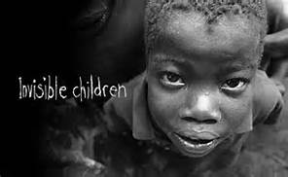
It’s a Human Issue:
http://www.youtube.com/watch?v=NjIV5XMWPAg&feature=player_embedded
invisiblechildren.com

Slide 23
Child Soldiers Global Report, 2008 Coalition to stop the use of Child Soldiers
While there may appear to be downward trend in the number of conflicts in which children are involved, it is more likely the result of conflicts ending rather than reducing the amount soldiers.
The military recruitment of children under 18 and their use in hostilities takes place in 86 countries and territories worldwide.
They are used unlawfully in armed groups, government forces, in militias or other groups, spies, and peacetime armies.
While much international attention has been given to the problem, many children are still at risk. A complex range of coordinated efforts is required for the prevention of child soldiering, release of existing child soldiers, and rehabilitation.
http://tbinternet.ohchr.org/Treaties/CCPR/Shared%20Documents/NPL/INT_CCPR_NGO_NPL_14605_E.pdf

Slide 24
According to the United Nations, there are several causes of Child Recruitment:
Forced recruitment using abduction and fear
Poverty may draw them to join the armed forces, or being made to think they are key to the “defense of their community.”
While there may be “voluntary” enlistment, it is usually a desperate act for survival.

Slide 25
Six Grave Violations: United Nations Security Council
The United Nations has defined six violations against children in cases of armed conflict:
Killing and maiming of children;
Recruitment or use of children as soldiers;
Sexual violence against children;
Attacks against schools or hospitals;
Denial of humanitarian access for children;
Abduction of children.
http://childrenandarmedconflict.un.org/effects-of-conflict/six-grave-violations/

Slide 26
Girl Soldiers
* Girls are often forced into soldiering, but have the heightened risk of sexual violence and exploitation.
* Girls are often forced into marriage and early pregnancy.
* Even after the perpetrators release other child soldiers, girls are often kept captive as wives.
* When/if they do make it back home, they are often stigmatized and rejected by their home communities due to the “taint” of being raped.
* They are often bypassed for “reintegration programs” for this reason.
http://invisiblechildren.com/media/videos/products/mothers-day-2013-meet-grace/
http://childrenandarmedconflict.un.org/effects-of-conflict/girl-child/

Slide 27
63 abducted women, girls escape from Boko Haram
By Aminu Abubakar and Holly Yan, CNN
updated 4:43 PM EDT, Mon July 7, 2014
Nigerians protest over kidnapped schoolgirls
http://www.cnn.com/2014/07/07/world/africa/nigeria-boko-haram-women-escape/index.html

Slide 28
DoSomething.org
Eleven Facts about child soldiers….
https://www.dosomething.org/facts/11-facts-about-child-soldiers

Slide 29
Child Soldiers Global Report, 2008 Coalition to stop the use of Child Soldiers continued…
International steps have been taken to protect children :
1. Criminal responsibility for those who recruit and use children have come in the form of war crimes charges issued by the International Criminal Court (ICC).
This has occurred in the DRC, Uganda, and Sierra Leone.
2. The Optional Protocol to the Convention of the Rights of the Child on the involvement of children in armed conflict was ratified, as of 2008, by 120 states.
3. The UN Security Council adopted resolutions creating monitoring systems for children and armed conflict, focusing on 6 categories of grave abuse against children.
4. The Paris Principles and Guidelines on children associated with armed forces or armed groups was endorsed in 2007 by 66 governments. It focuses on guidance to protect children from recruitment and providing assistance to those involved in armed forces.
Cote d’Ivoire, Sri Lanka, and Myanmar are working with the UN regarding the recruitment of child soldiers.

Slide 30
It is not going away…
“ When armed conflict breaks out, reignites, or intensifies, children will almost inevitably become involved as soldiers…”
Key areas: Central African Republic, Chad, Iraq, Somalia, Sudan (Darfur), Uganda, Myanmar, and more recently, Syria….

Slide 31
Syria
“Children interviewed for the report said they had fought in battles, acted as snipers, manned checkpoints, spied on hostile forces, treated the wounded on battlefields and transported ammunition and supplies to the front lines during fighting…”
http://www.ibtimes.co.uk/syria-child-soldiers-young-15-thrown-onto-front-lines-by-isis-1453768
“The report, titled Maybe We Live and Maybe We Die, documents the experiences of 25 children and former child soldiers in Syria's armed conflict. Human Rights Watch interviewed children who fought with the Free Syrian Army, the Islamic Front Coalition and the extremist groups Isis and Jabhat al-Nusra, an Al-Qaeda affiliate, as well as the military and police forces in Kurdish-controlled areas.”

Slide 32
Recent News…
https://uk.news.yahoo.com/child-soldiers-worst-countries-recruiting-underage-fighters-130152737.html#qa2dhJx
“Child Soldiers: Which are the Worst Countries for Recruiting Underage Fighters?”

Slide 33
Human Rights Watch
“UN Report Shames Wartime Abusers of Children”
http://www.hrw.org/news/2014/07/01/un-report-shames-wartime-abusers-children

Slide 34
What to do?

Slide 35
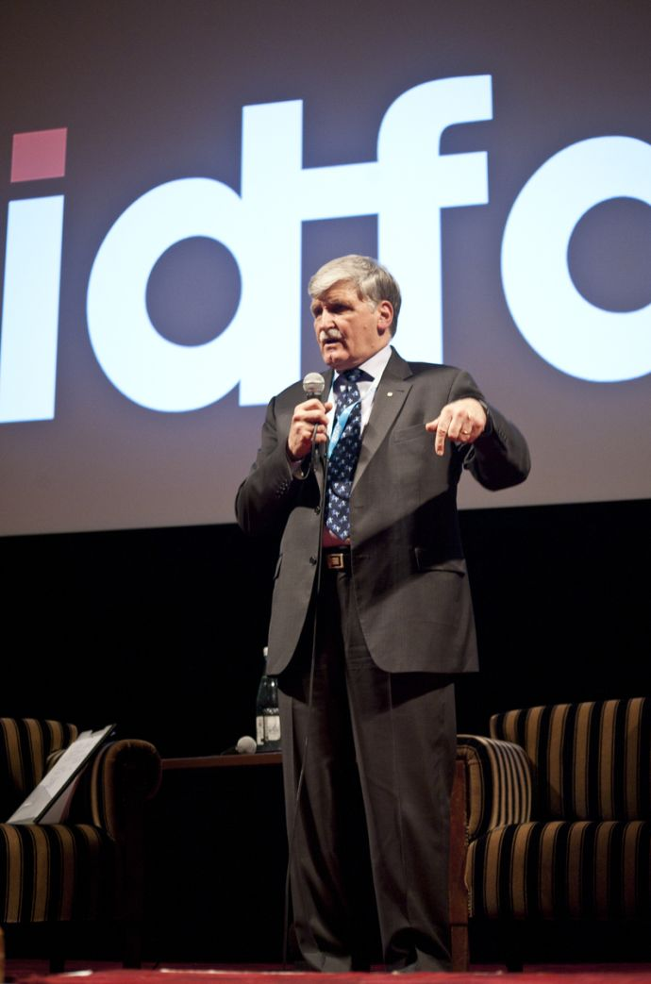
“Our mission is to develop and implement new strategies and tactical guidance to eradicate the use and recruitment of child soldiers around the world.”
* Their model: training, research,
and advocacy.
http://www.childsoldiers.org/who-we-are-2/

Slide 36
Several Organizations…
The United Nations: http://www.un.org/en/rights/
Invisible Children: http://invisiblechildren.com/
Amnesty International: http://www.amnesty.org/

Slide 37
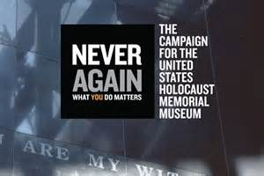
Do Something: https://www.dosomething.org/
Human Rights Watch: http://www.hrw.org/
United States Holocaust Memorial Museum: www.ushmm.org/

Slide 38
STAND UP: http://www.standnow.org/
http://www.child-soldiers.org/global_report_reader.php?id=97
Child Soldiers International: http://www.childsoldiers.org/

Slide 39
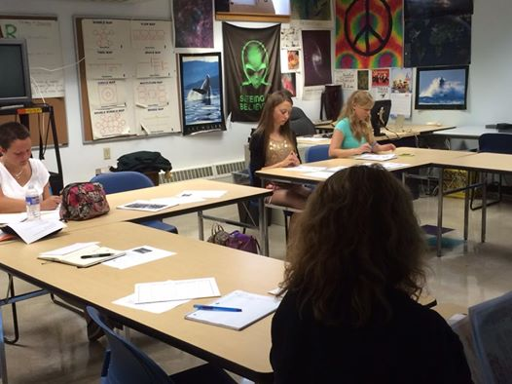
And YOU….

Slide 41
Child Soldier Stories
Find a story about a child soldier and create a “document” that includes the following information, if available:
Name, age, and location of child.
Reason for becoming a child soldier.
Key elements of experience.
How/why he or she was released, escaped, or left voluntarily.
Impact on the individual.
Any reference by story teller as to how he/she was able to survive.

Slide 42
Presentation of Story…
Create a visually appealing structured organizer of your individual’s story, with a picture of the individual, or a picture representing something about the individual, as the focal point. Other pictures, charts, graphs or maps may also be incorporated
Examples include but are not limited to a web design chart, flow chart, timeline, cause and effect chart, etc.
This can be done using word, as a power point slide, a Prezi, using a timeline program, or the old fashioned way (and probably much easier !) on paper using coloring utensils, with a print out though of your pictures.

Slide 43
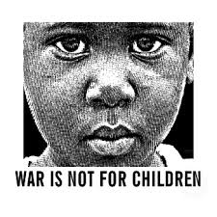
Generic Example:
Name of Individual
Background info
Events
Events
How they were rescued
How they
survived
Main image
* Images can also be added throughout if desired…

