Slide 1
Liberation~ The Plight of the Survivors of the Holocaust
“ How could we [the world] have stood by and let that happen to them? We owe them.”
Carrol Walsh
743 Tank Battalion
Liberator
Rozell, Matthew. Quotes from the American Soldiers/Holocaust Survivors Reunion, Hudson Falls High School, New York, USA; 9/22-9/26/2009. World War II Living History Project/Teaching History Mattershttp://teachinghistorymatters.wordpress.com. Accessed (June 25,2015)

Slide 2
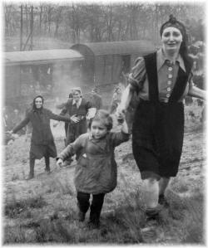
A Fantastic and True Story…
https://www.youtube.com/watch?v=EABunbR7aAg
Friday, April 13th, 1945.
Moment of Liberation.
Farsleben, Germany
CREDIT: U.S. Army,
Major Clarence Benjamin,
743rd Tank Battalion
Rozell, Matthew. World War II Living History Project/Teaching History Mattershttp://teachinghistorymatters.com. Accessed (June 25, 2015).

Slide 3
Brief Chronology of Liberation...
February 2, 1943: German defeat at Stalingrad
April 1943, October 1943: Warsaw and Sobibor uprisings,
November 1943: Operation Harvest Festival
May 1944: Germans deport Hungarian
Jews after invading Hungary
June 6, 1944: D-Day- frees France
June 18, 1944: Auschwitz report by two Slovak inmates who escaped
July 23rd, 1944: Lubin-Majdanek liberated by Soviets
October 1944: Prisoner revolt at Auschwitz-
Birkenhau
January 27, 1945 Auschwitz liberated by Soviets
February 1945: Gross-Rosen liberated by Soviets

Slide 4
April 4 1945: Liberation of Ohrdruf, subcamp of Buchenwald
-US troops liberated- leading to all of
Buchenwald being liberated days later.
April 12, 1945: Westerbork camp liberated by Canadian forces
April 15, 1945: Bergen-Belsen liberated by British
April 29, 1945 Dachau liberated by US troops
May 5, 1945: Liberation of Mauthausen by US Troops
May 7, 1945: Germany surrenders
These dates and more are included in a comprehensive, detailed timeline with resources in the United States Holocaust Memorial Museum’s website:
http://www.ushmm.org/learn/timeline-of-events/1942-1945

Slide 5
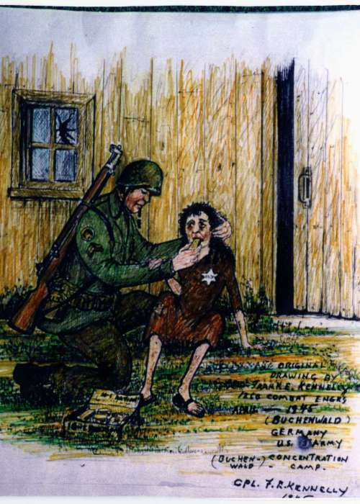
Artifact from liberator: Reflection
US forces liberated the Buchenwald concentration camp on April 11, 1945. Corporal Frank Kennelly of Philadelphia, a member of the 1260th Combat Engineers, drew this piece to commemorate what he saw at Buchenwald.

Slide 6
Activity
Overarching questions:
What problems came about with liberation?
2. What was different, and what was the same, about the testimonies from the liberators and the inmates? (compare and contrast). Analyze any differences taking into account point of view.
3. Context: What broader issues of concern existed in Europe, the United States, and the rest of the world around 1945?

Slide 7
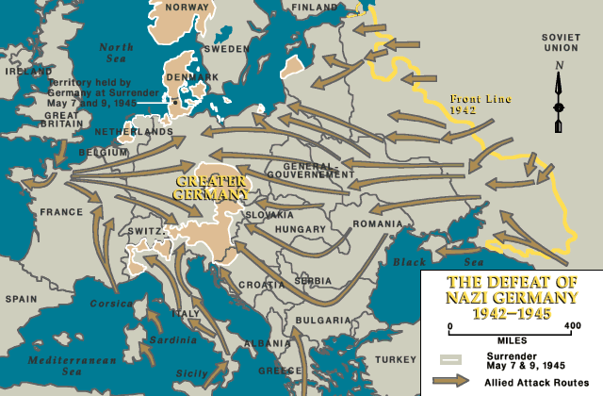
Liberation- Pure Joy?
Liberation was both a blessing and a burden...
~Prisoners during the Holocaust were often freed by Allied soldiers as they pushed German soldiers back to Germany.
http://www.ushmm.org/lcmedia/map/lc/image/eur86820.gif

Slide 8
Liberation~Problems
As Allied soldiers discovered camp after camp, the problems with liberation emerged:
Many prisoners had survived forced marches, or “death marches,” into the interior of Germany from camps in occupied Poland. These prisoners were suffering from starvation and disease. Liberation meant the freedom that they longed for; yet their physical condition was often a considerable issue.
More than 10,000 prisoners died in Bergen-Belsen after liberation due to the effects of malnourishment and disease.
http://www.ushmm.org/wlc/en/article.php?ModuleId=10005131

Slide 9
Liberation: Problems
While the needs and concerns of the individual prisoners were paramount, soldiers also dealt with camp epidemics
Entire camps had to be destroyed due to rampant diseases and filth
Victims were also simply “left” by Nazi’s who
abandoned them in an effort to flee from Allied forces-in some cases on trains, or in warehouses, without supplies.
~Marion Blumenthal Lazan, Gerda Weissmann-Klein

Slide 10
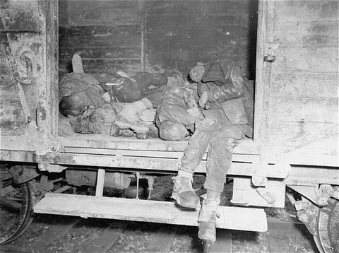
Corpses lie in one of the open railcars of the Dachau death train. The Dachau death train consisted of nearly forty cars containing the bodies of between two and three thousand prisoners transported to Dachau in the last days of the war. Dachau, Germany, April 29, 1945. — US Holocaust Memorial Museum

Slide 11
Liberation: Problems
The liberating soldiers had to cope with the horrors that they stumbled upon..emaciated prisoners, evidence of genocide (piles of hair, clothing, jewelry, etc), terrible smells...but they were ordered by General Eisenhower to “document and publicize the evidence of Nazi atrocities...so that ordinary citizens become aware of the crimes which were committed in their midst, in their names, and with their permission."
http://www.ushmm.org/wlc/en/article.php?ModuleId=10006237

Slide 12
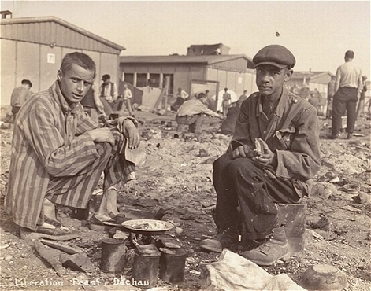
Two survivors prepare food outside the barracks. The man on the right, presumably, is Jean (Johnny) Voste, born in Belgian Congo, who was the only black prisoner in Dachau. Dachau, Germany, May 1945.
— US Holocaust Memorial Museum

Slide 13
"It is the desire of the Theater Commander that both still and moving pictures be utilized to the fullest extent practicable as exhibits in reports of investigations of war crimes committed by the Nazis with particular reference to Allied prisoners of war both in and out of camps and to concentration camps for the purpose of recording for civilization the history of horror written by over five years of German atrocities."
—Omar Bradley, April 24, 1945.
http://www.ushmm.org/wlc/en/article.php?ModuleId=10006237

Slide 14
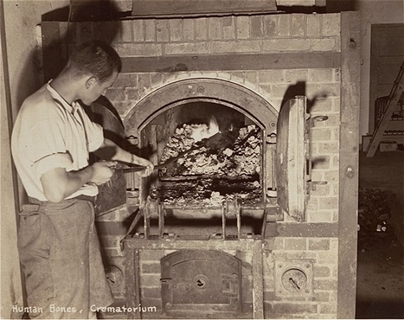
A survivor stokes smoldering human remains in a crematorium oven that is still lit.
Dachau, Germany, April 29-May 1, 1945.
— US Holocaust Memorial Museum

Slide 15
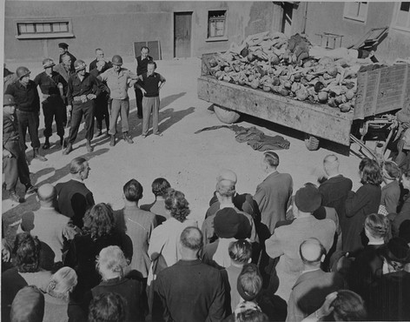
German civilians under US military escort are forced to view a wagon piled with corpses in the newly liberated Buchenwald concentration camp. Buchenwald, Germany, April 16, 1945. USHMM
—

Slide 16
Three specific camps...
Lublin-Majdanek
JULY 23, 1944
Soviet forces liberated the Lublin-Majdanek concentration camp (located three miles east southeast of Lublin) and find fewer than 500 prisoners left in the camp.
In late July 1944, as Soviet forces approached Lublin, the remaining camp staff hastily abandoned Majdanek, without fully dismantling the camp.
Soviet troops first arrived at Majdanek during the night of July 22–23 and captured Lublin on July 24.
Captured virtually intact, Majdanek was the first major concentration camp to be liberated. Soviet officials invited journalists to inspect the camp and evidence of the horrors that had occurred there.
http://www.ushmm.org/learn/timeline-of-events/1942-1945/liberation-of-lublin-majdanek

Slide 17
Majdanek Continued….
Majdanek….the year before:
On November 3, 1943, in Operation "Erntefest" (Harvest Festival), special SS and police units dispatched to Lublin specifically for that purpose shot 18,000 Jews just outside the camp. At least 8,000 of the victims were Majdanek prisoners; the remaining 11,000 were forced laborers from other camps or prisons in Lublin city. During the operation, music was played throughout the camp over loudspeakers to drown out the sounds of mass murder. This massacre at Majdanek on November 3, 1943, was, in the number of victims, the largest single-day, single-location killing during the Holocaust.
http://www.ushmm.org/wlc/en/article.php?ModuleId=10005190

Slide 18
Auschwitz
2. Auschwitz
January 27, 1945
The Soviet army entered Auschwitz, Birkenau, and Monowitz and liberated around 7,000 prisoners, most of whom were ill and dying.
In mid-January 1945, the SS began evacuating Auschwitz and its subcamps- forcing nearly 60,000 prisoners to march west from the Auschwitz camp system.
Thousands had been killed in the camps in the days before these death marches began. Auschwitz-Birkenau was the killing center at Auschwitz. Almost all of the deportees who arrived at the camps were sent immediately to death in the gas chambers.
It is estimated that the SS and police deported at a minimum 1.3 million people to Auschwitz complex between 1940 and 1945. Of these, the camp authorities murdered 1.1 million.

Slide 19
Auschwitz continued…
Video:
http://www.ushmm.org/learn/timeline-of-events/1942-1945/soviet-forces-liberate-auschwitz
7o year anniversary show:
http://www.cnn.com/videos/world/2015/01/26/pkg-watson-poland-auschwitz-70-years-later.cnn

Slide 20
Dachau
3. Dachau
APRIL 29, 1945
The 42nd and 45th Infantry Divisions and the 20th Armored Division of the US Army liberated approximately 32,000 prisoners at Dachau.
On April 26, 1945, as American forces approached, there were 67,665 registered prisoners in Dachau and its subcamps; more than half of this number were in the main camp. Of these, 43,350 were categorized as political prisoners, while 22,100 were Jews, with the remainder falling into various other categories.
Starting that day, the Germans forced more than 7,000 prisoners, mostly Jews, on a death march from Dachau to Tegernsee far to the south. During the death march, the Germans shot anyone who could no longer continue; many also died of hunger, cold, or exhaustion.

Slide 21
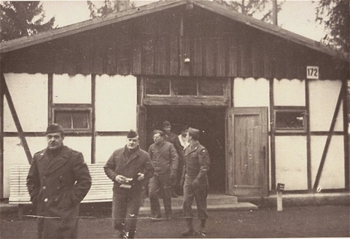
Dachau continued….
On April 29, 1945, American forces liberated Dachau. As they neared the camp, they found more than 30 railroad cars filled with bodies brought to Dachau, all in an advanced state of decomposition. In early May 1945, American forces liberated the prisoners who had been sent on the death march.
American soldiers finish their inspection of Dachau's first crematorium. Dachau, Germany, November 18, 1945.
— US Holocaust Memorial Museum

Slide 22
Video Testimonies
http://www.ushmm.org/wlc/en/gallery.php?ModuleId=10005131&MediaType=OI
Bart Stern
Gerda Weissmann-Klein
Kurt Klein
http://popchassid.com/photos-holocaust-narrative/
Twenty pictures….

Slide 23
After Liberation: What Next?
Displaced Persons Camps
From 1945-1952 more than 250,000 “displaced persons” (dp’s) lived in camps in urban areas in Germany, Austria and Italy.
These facilities were administered by Allied authorities
and the United Nations Relief and Rehabilitation Administration (UNRRA).
They were often contained in former concentration camps (can you imagine?!) or German army camps
(This and the next several slides were taken from the following page of the USHMM website:)
http://www.ushmm.org/wlc/en/article.php?ModuleId=10005462

Slide 24
Quick brainstorm:
With a partner or two, list three immediate concerns of the Displaced Persons Camps, from either the perspective of the survivors or the UNRRA officials, or both:
1.
2.
3.

Slide 25
Issues for DP’s:
Common issues:
Reuniting with families
Often new families were created-marriages and births were common in the DP camps
Schooling and the continuation of Jewish traditions
Revival of cultural and social life-theater and musical groups, new publications, athletic groups, and many other social and occupational groups were created.
Zionism grew, as Jews sought to move to Israel, aided by David Ben Gurion’s efforts.
Emigration was a major issue as Allied autorities prepared to help Jews back to their “homes,” yet Jews were reluctant to return….and often felt that they could not.

Slide 26
Emigration continued….
Hostility emerged between the US and Britain over emigration policies to British controlled Palestine
US wanted Britain to ease restrictions; Britain resented US intereference
Britain's rejection a committee report strengthened the resolve of many Jews to reach Palestine and, from 1945-1948, the Brihah ("escape") organization moved more than 100,000 Jews past British patrols and illegally into Palestine.
British seaman often seized these ships and interned those aboard in Cyprus, generating sympathy for Jewish immigrants.

Slide 27
Emigration: Final
On May 14, 1948, the United States and the Soviet Union recognized the state of Israel.
Congress also passed the Displaced Persons Act in 1948, authorizing 200,000 DPs to enter the United States.
By 1952, over 80,000 Jewish DPs had immigrated to the United States under the terms of the DP Act and with the aid of Jewish agencies.
With over 80,000 Jewish DPs in the United States, about 136,000 in Israel, and another 20,000 in other nations, including Canada and South Africa, the DP emigration crisis came to an end. Almost all of the DP camps were closed by 1952. The Jewish displaced persons began new lives in their new homelands around the world. http://www.ushmm.org/wlc/en/article.php?ModuleId=10005462

Slide 28
One final thought….
What about the emotional state of the survivors? The “serious mental harm?”
Not used to regular social norms
Not used to personal hygiene practices (especially if they were children)
Nightmares
Fear
* Marion Blumenthal Lazan, who was ten when imprisoned, had never been to a store...never shopping...when she was liberated.

Slide 29
“That night, I went to the famous Hofbrauhaus in Munich, to wash the images of the ovens away with some beer. I hadn’t been there long when an elderly American couple sat at the table. They were from Florida, a pleasant couple. He had been a young lieutenant in the American army on the push into Munich. In fact, it had been his pleasure to liberate the Hofbrauhaus from the Germans.
Of course, I asked the question. “Were you at Dachau?”
He didn’t answer for several seconds, tears glistening in the corners of his eyes as his wife’s hand covered his and squeezed. Finally, he nodded, reached into a back pocket and pulled out his wallet.
With a flick of his wrist, a photo, just as wrinkled, just as bent, as the one my father had carried landed on the table. It wasn’t the same scene, but one just like it.

Slide 30
Here was my chance, the opportunity to ask the question I had never been able to ask my father. I pulled the photo from my own wallet and lay it next to his. “Why? Why have you carried it so long? To remind you of the horror of Dachau, of what had been done here?”
His face carried the faintest of smiles as he shook his head. “No, son, to remind us of the horrors that we are capable of, to remind us not to go down that road again.”
The difference was subtle, but in that moment, I learned two lessons invaluable to a writer, subtle differences are important, and when you want to know the truth, go to the source.
As I sit here now and look at that same photograph, I realize that it was my father’s legacy to me, of Dachau.
Now, nearly 70 years after that day in 1945, Dachau is still with us, and I hope the legacy left by our fathers always will be.”
Tony Hayes, reflecting on his father….
http://teachinghistorymatters.com/2015/04/29/dachau-seventy-years-on/

Slide 31
Eisenhower’s famous quotation:
The things I saw beggar description... The visual evidence and the verbal testimony of starvation, cruelty and bestiality were...overpowering... I made the visit deliberately in order to be in a position to give first-hand evidence of these things if ever, in the future, there develops a tendency to charge these allegations merely to ‘propaganda.’
Source: General Dwight D. Eisenhower’s letter to General George C. Marshall dated April 15, 1945
http://www.ushmm.org/research/research-in-collections/search-the-collections/bibliography/liberators

Slide 32
Reflection:
Using what we have dicussed today, describe why liberation was both a blessing and a burden.
Can you connect this to the “legacy” Tony Hayes referrerd to with both the picture of Dachau that he found in his father’s wallet and the conversation he had with another liberator with a similar picture?

Slide 33
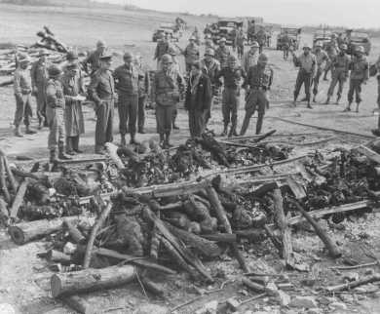
General Dwight D. Eisenhower (third from left) views the charred remains of inmates of the Ohrdruf camp. Ohrdruf, Germany, April 12, 1945. — US Holocaust Memorial Museum

