Slide 1
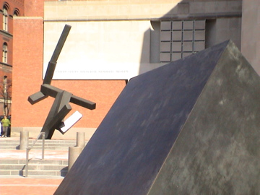
MCDOWELL HIGH SCHOOL
UNITED STATES HOLOCAUST MEMORIAL MUSEUM
WASHINGTON DC VISIT
MONDAY FEBRUARY 23, 2015

Slide 2

GOOD AFTERNOON!
THIS MEETING COVERS SOME IMPORTANT DETAILS THAT WILL HELP YOU GET THE MOST OUT OF THIS TRIP

Slide 3
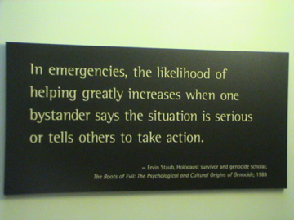
AS YOU CAN IMAGINE, THIS DAY INVOLVES THE STUDY HORRIFIC EVENTS
BOTH PAST AND PRESENT

Slide 4
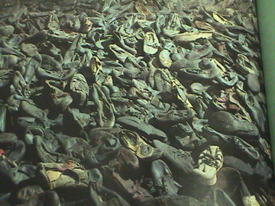
AS DIFFICULT AS IT MIGHT BE THIS WILL BE A DAY YOU WON’T SOON FORGET

Slide 5
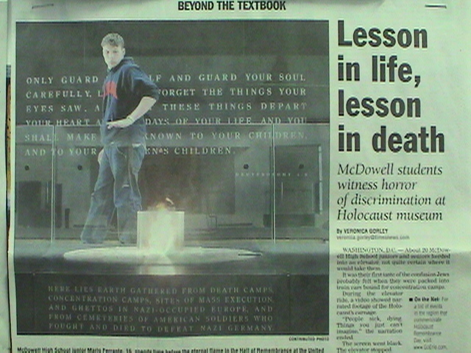
THE TRIP WILL CHALLENGE YOU IN SEVERAL WAYS

Slide 6
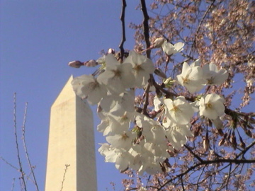
FIRST OFF - LONG DAY,
MANY MILES!
PACE YOURSELF!

Slide 7
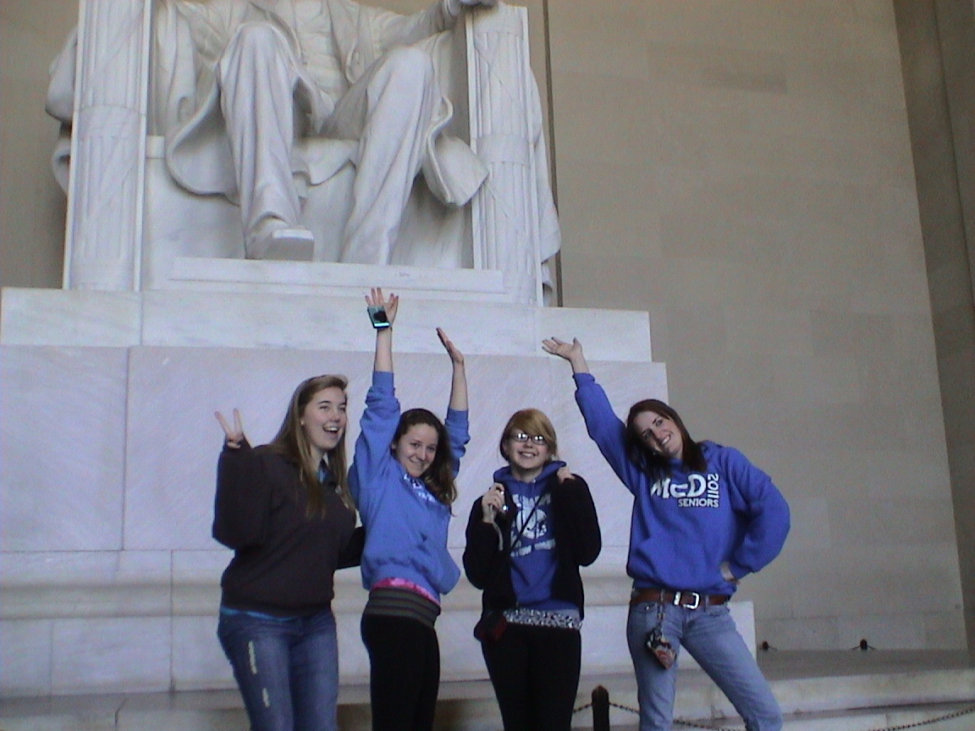
ALTHOUGH THE DAY MAY BE INTENSE PLEASE TRY AND “ENJOY” THE EXPERIENCE

Slide 8
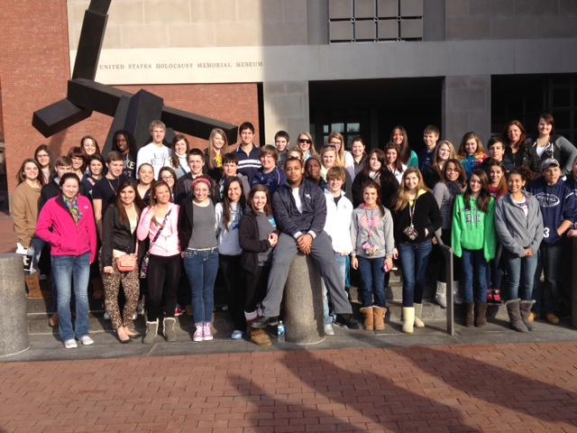
YOU WILL BE TRAVELING WITH TOLERANCE STUDENTS, HISTORY STUDENTS, STAFF
AND FACULTY. BE NICE!!

Slide 9
THIS DAY INVOLVES A GREAT DEAL OF PLANNING AND EXPENSE. IT IS MADE POSSIBLE BY THE
ERIE HOLOCAUST EDUCATION FUND
AND THE
JEWISH COMMUNITY COUNCIL OF ERIE

Slide 10
THE TOTAL COST OF TRIP EXCEEDS $3,000
YOUR $25 DONATION WILL BE PLACED BACK INTO THE HOLOCAUST EDUCATION FUND AT THE ERIE COMMUNITY FOUNDATION
THANK YOU!!

Slide 11
THIS HELPS KEEP THE FUND SOLVENT AND ALLOW FOR STUDENTS TO MAKE THE TRIP WELL INTO THE FUTURE.
YOUR HELP IS GREATLY APPRECIATED!

Slide 12
IF ANYTHING COMES UP BETWEEN TODAY AND OUR DEPARTURE ON MONDAY AND YOU CAN’T TRAVEL - PLEASE LET MR. HODERNY KNOW.
WE WILL THEN PLACE A STUDENT FROM THE WAITING LIST

Slide 13
IF ANY LAST MINUTE PROBLEMS OR QUESTIONS COME UP,
PLEASE CONTACT
MR. HODERNY
814-873-4755

Slide 14
ALSO
TO HELP PREPARE YOU FOR THE MUSEUM VISIT
I SUGGEST YOU LOG ON TO
USHMM.ORG
PRIOR TO OUR DEPARTURE

Slide 15
AND YES!
THERE IS AN APP FOR THE MUSEUM.
THAT HAND OUT IS BEING PASSED AROUND.
THIS MAY HELP ENHANCE THE QUALITY OF YOUR VISIT.

Slide 16
I WILL PASS AROUND A FOLDER TODAY. THIS FOLDER WILL BE GIVEN TO EACH OF YOU ON MONDAY.
IT CONTAINS MATERIAL THAT YOU WILL USE THROUGHOUT THE DAY.

Slide 17
THESE WILL BE DISTRIBUTED ON BUS AFTER FIRST STOP.
THEY ARE YOURS TO USE ON THE TRIP AND YOURS TO KEEP.

Slide 18
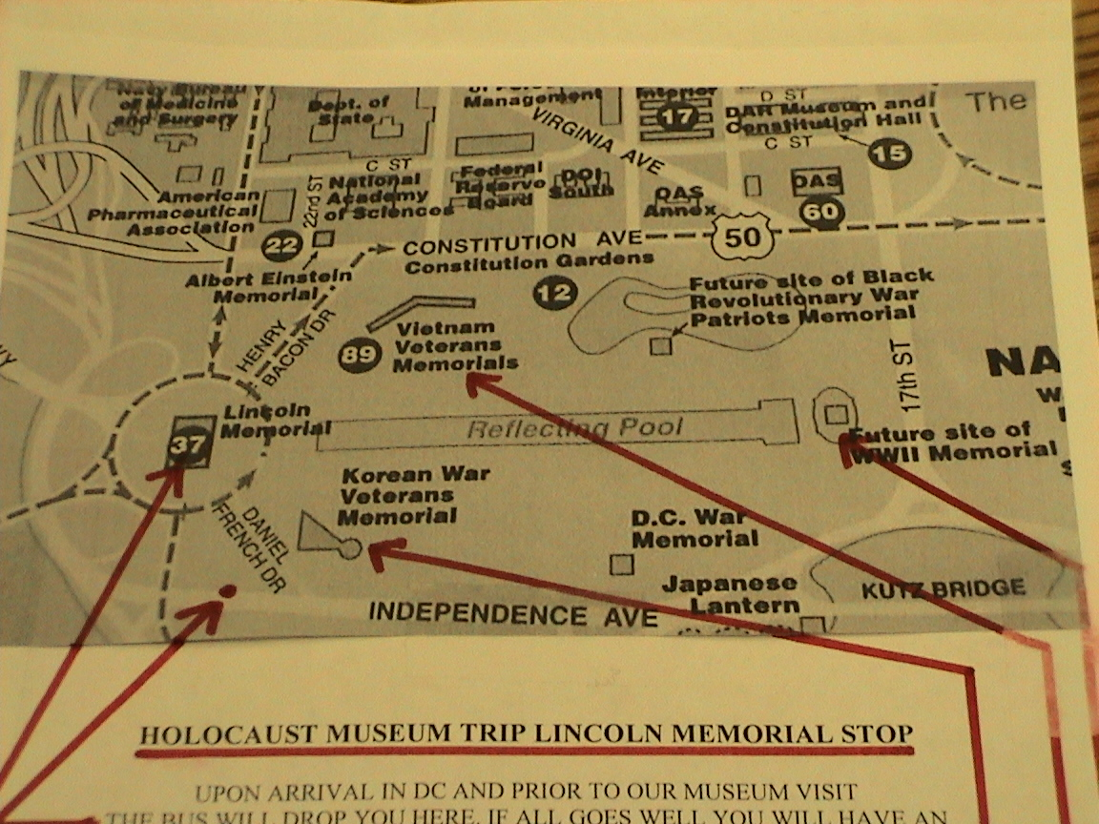
IN YOUR FOLDER YOU WILL FIND THIS HANDOUT FOR OUR STOP PRIOR TO MUSEUM TOUR

Slide 19
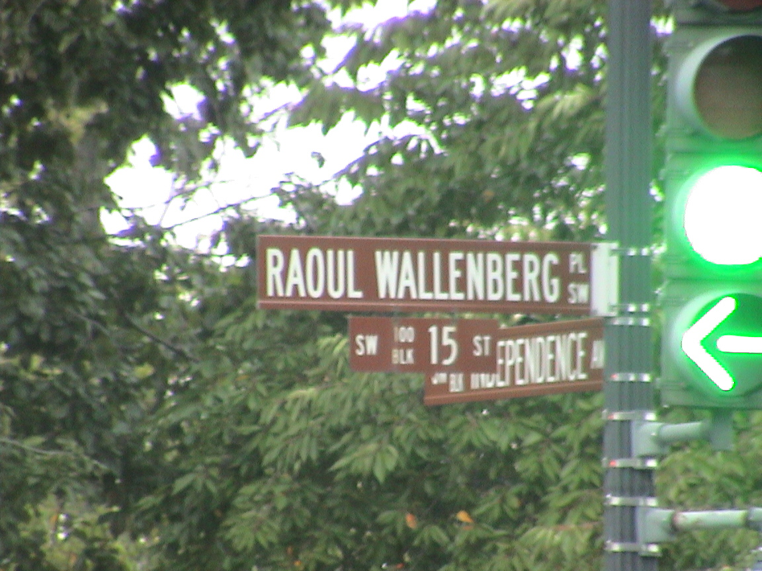
YOU ARE VERY FORTUNATE TO BE PART OF THIS DAY! NOT MANY CLASSES END UP AT THE INTERSECTION OF WALLENBERG PLACE AND INDEPENDENCE AVE

Slide 20
ALSO REMEMBER THAT IN RETURN FOR THE PRIVILEDGE OF TRAVELING ON THIS TRIP YOU AGREE TO THE FOLLOWING:
PARTICIPATE IN THE DAYS ACTIVITIES ON THE TRIP TO THE MUSEUM.
ONE PAGE TYPED REFLECTION OF YOUR EXPERIENCE THAT DAY – DUE ONE WEEK FROM THE TRIP.
MAKE THE BEST USE OF YOUR TIME IN THE MUSEUM – UP TO THE LAST MINUTE!!
NO DOWN TIME WHILE IN THE MUSEUM.

Slide 21
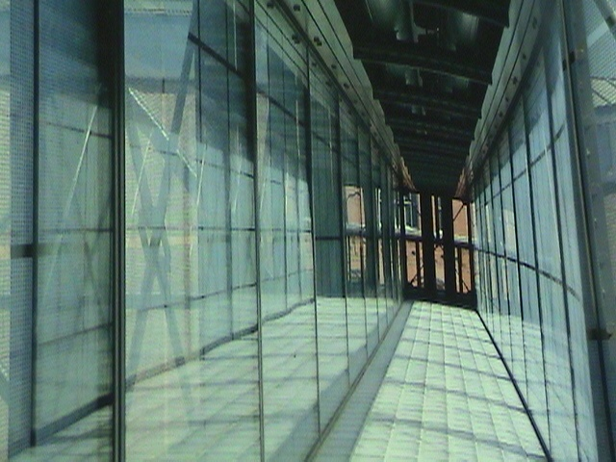
SOME DETAILS THAT MIGHT HELP…

Slide 22
BUS WILL DEPART MCDOWELL HIGH SCHOOL WEST 38TH STREET PARKING LOT AT
5AM - NOT A MINUTE LATER!
COACH USA
YOU WILL PICK YOUR SEAT AS YOU ARRIVE
YOU DECIDE WHAT TIME TO ARRIVE.

Slide 23
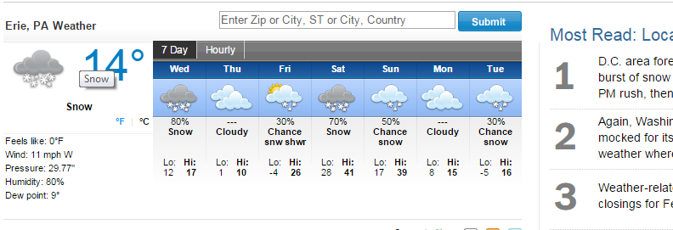
ERIE WEATHER FIRST

Slide 24
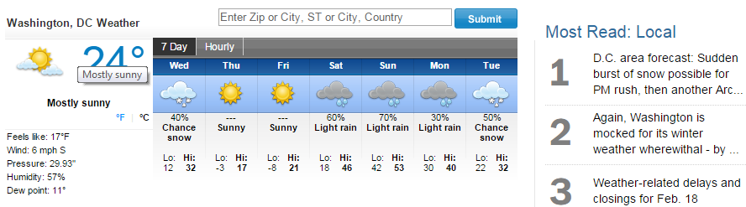
WEATHER FORECAST?
NOT BAD CONSIDERING THE TIME OF YEAR

Slide 25
WHAT SHOULD YOU BRING?
PILLOW & STUFF, MUSIC,
SNACKS FOR BUS
LUNCH FOR ON THE BUS
MOVIES FOR TRIP BACK!
CAMERA WITH LOTS OF MEMORY
$$ FOR TWO MEALS & WHATEVER
PROPER DRESS FOR THE WEATHER
DRESS WARM

Slide 26
OTHER “STUFF” TO CONSIDER:
DRESS CASUAL BUT RESPECTABLE
DROP OFF AT LINCOLN MEMORIAL PRIOR TO MUSEUM VISIT, PAY CLOSE ATTENTION TO PICK-UP POINT, MAP WILL BE PROVIDED IN YOUR FOLDER.
DO NOT GO ANYWHERE ALONE - STAY WITH OTHERS AT ALL TIMES.
CELL PHONE CONTACT ALSO IN FOLDER.

Slide 27
MUSEUM SECURITY
VERY TIGHT - AIRPORT MODE
BRING AS LITTLE AS POSSIBLE INTO MUSEUM SECURITY ENTRANCE
PICTURES ENCOURAGED EXCEPT IN THE MAIN EXHIBITION
DO NOT LEAVE MUSEUM AT ANY TIME PRIOR TO GROUP MEETING!!!!!!!!!!!!!!!!!!!
TAKE YOUR TIME!!
PLEASE TURN OFF CELL OUT OF RESPECT
LEAVE HATS ON BUS PLEASE - RESPECT!

Slide 28
WHAT TO SEE IN MUSEUM
MAIN EXHIBITION
DANIEL’S STORY
SOME WERE NEIGHBORS
GENOCIDE EXHIBITION
NUREMBERG EXHIBITION
HALL OF WITNESS
HALL OF REMEMBRANCE
CHILDREN’S TILE WALL
BOOK STORE & GIFT SHOP

Slide 29
IF YOU WERE TO VIEW THE ENTIRE MUSEUM INCLUDING ALL THE EXHIBITS - IT WOULD TAKE AT LEAST A WEEK!
DO THE BEST YOU CAN,
SEE WHAT INTEREST YOU,
MAKE THE BEST OF THE TIME YOU HAVE!!

Slide 30
CONSIDERING THE TIME AND EXPENSE INVOLVED IN GETTING YOU TO THE MUSEUM,
PLEASE USE ALL THE TIME YOU HAVE!!
IT MAKES NO SENSE FOR YOU TO SIT IDOL IN THE LOBBY.
CARPE DIEM!!

Slide 31
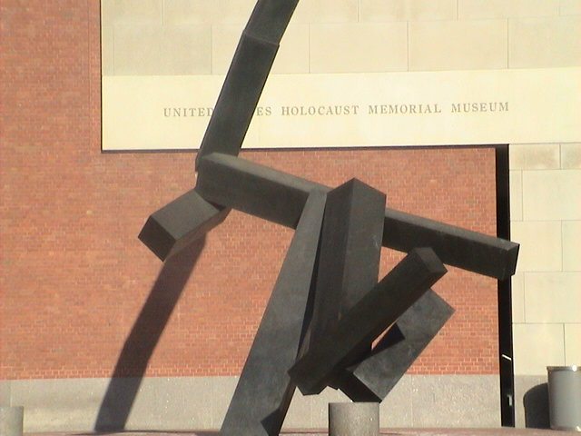
WHAT WILL YOU DISCOVER WHILE VISITING THE MUSEUM??

Slide 32
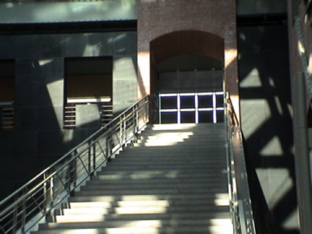
THE ARCHITECT WANTED YOU TO SENSE THAT “SOMETHING IS AMISS…”

Slide 33
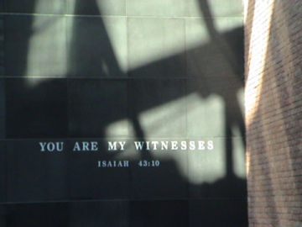
IF YOU LISTEN, THIS BUILDING WILL
“ SPEAK TO YOU!”

Slide 34
IT WILL CRY OUT…
“NEVER AGAIN”

Slide 35
WHY BUILD A MUSEUM FOR SUCH AN EVENT, SUCH A MEMORY?
TESTIMONY TO LIVES AND EVENTS WE MUST NEVER FORGET
A FUNDAMENTAL LESSON THAT, TO BE A BYSTANDER IS TO SHARE IN THE GUILT
A MEMORIAL TO THE VICTIMS
SO WE DON’T FORGET!!

Slide 36
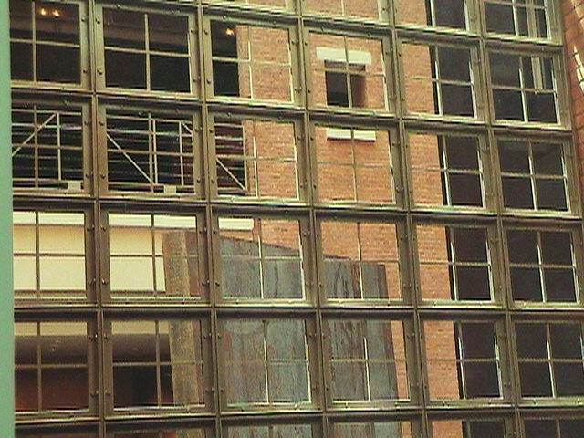
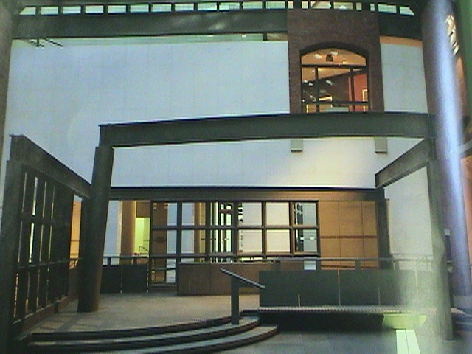
THE BUILDING IS AN ARCHITECTURAL MASTERPIECE
IT DECEIVES YOU!
IT HIDES THINGS FROM YOU!
IT HAS HIDDEN MEANINGS THROUGHOUT!

Slide 37
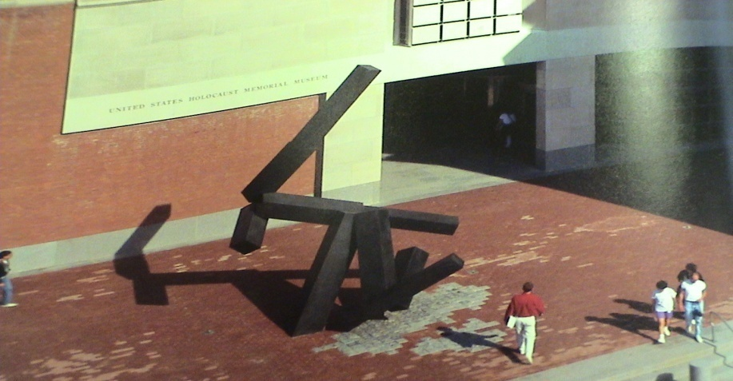
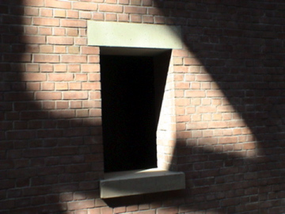
DESIGN BY JAMES FREED
“THE BUILDING WILL TAKE YOU IN IT’S GRIP”
“NOT ALL IS QUITE AS IT SEEMS”

Slide 38
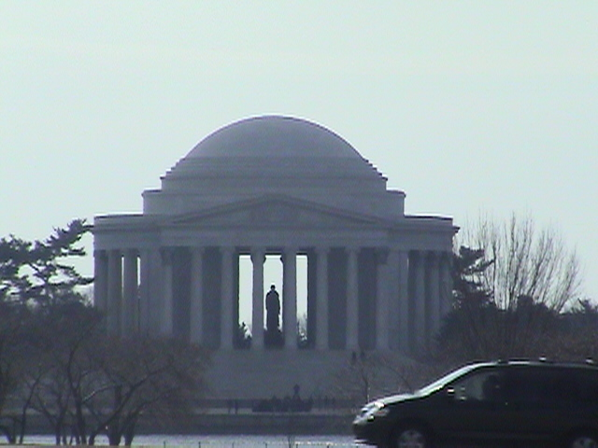
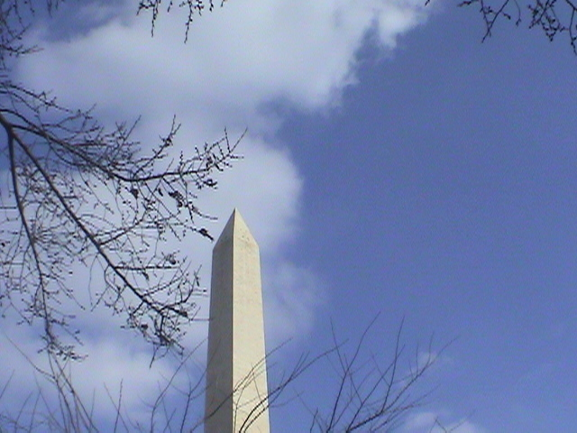
OPENED IN APRIL OF 1993
LOCATED IN CENTER OF DC
TWO BLOCKS FROM WASHINGTON MONUMENT
WITHIN VIEW OF CAPITAL, WHITE HOUSE AND JEFFERSON MEMORIAL

Slide 39
EXTERIOR BLENDS IN WITH WASHINGTON
ONCE INSIDE THE MUSEUM YOU WILL FORGET
WHERE YOU ARE…
YOU PASS FROM THE LIMESTONE WORLD OF PRESENT DC TO THE RED BRICK AND STEEL WORLD OF THE 1940’S

Slide 40
JUST AS THE HOLOCAUST DEFIES UNDERSTANDING, THE BUILDING ITSELF IS NOT MEANT TO BE UNDERSTOOD
THE MUSEUM EXPERIENCE IS WHAT YOU MAKE IT !

Slide 41
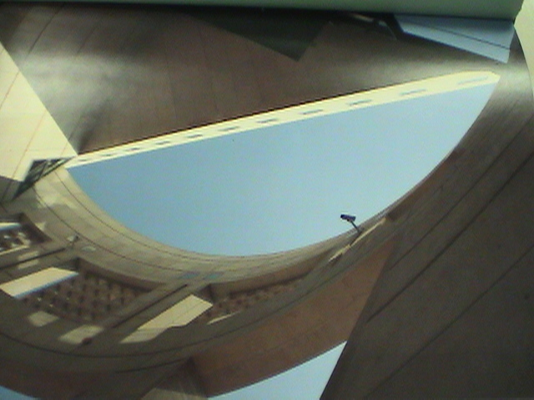
OUTSIDE: A MERE FACADE, A FAKE SCREEN THAT COVERS THE REALITY YOU WILL EXPERIENCE ONCE INSIDE

Slide 42
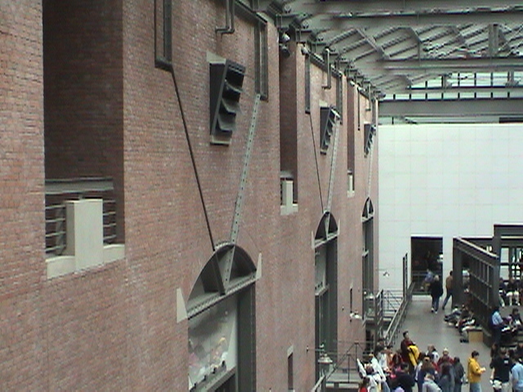
ONCE INSIDE: A WORLD OF BRICKS, TOWERS, SENTRY BOXES, ARCHES, TRIANGLES, CONFUSION…

Slide 43
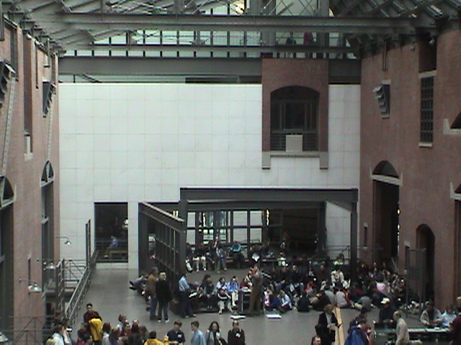
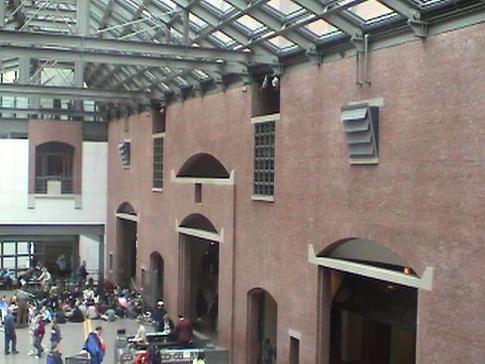
HALL OF WITNESS
MAIN LOBBY
CONFUSION
DECEPTION
YOU EXPERIENCE WHAT A PRISONER MIGHT HAVE EXPERIENCED INSIDE THE CAMPS

Slide 44
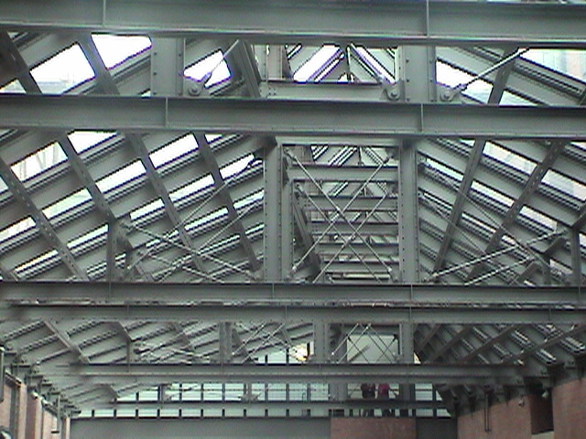
GLASS CEILINGS, DISTORTED AND TWISTED

Slide 45
WALLS DO NOT JOIN OR CONNECT, GAPS, MATERIALS DO NOT MATCH

Slide 46
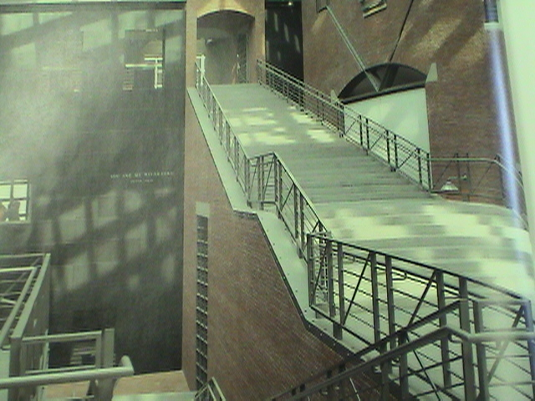
HALL OF WITNESS
STAIRCASE
SHADOWS
SUNLIGHT
CONFUSION

Slide 47
EXPOSED STEEL BEAMS, BOARDED WINDOWS, METAL RAILINGS, STEEL GATES, FENCES, BRIDGES; ALL DISTURBING SIGNALS OF SEPARATION.

Slide 48
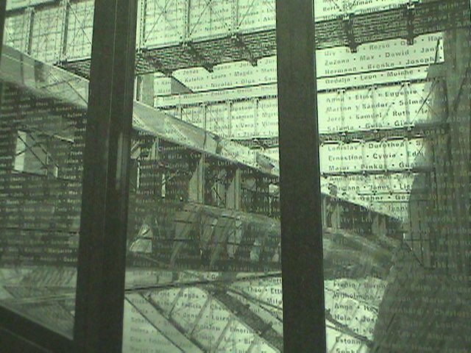
NO CONTACT, NO VIEW OF THE OUTSIDE WORLD. A SENSE THAT SOMEONE IS WATCHING YOU!

Slide 49
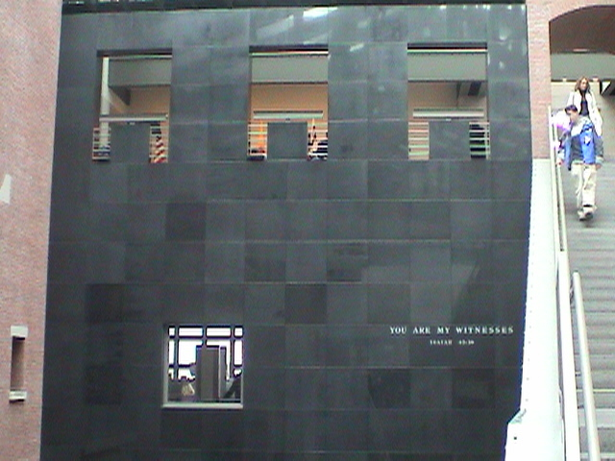
“YOU ARE IN A DIFFERENT PLACE NOW”

Slide 50
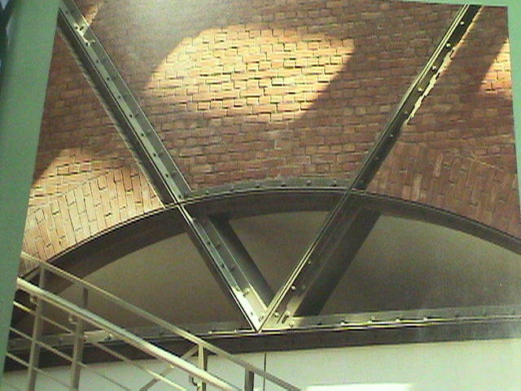
YOU GET A SENSE THAT “SOMETHING IS AMISS HERE”

Slide 51
THE MAIN EXHIBIT
BEGINS WITH ELEVATOR TO 4TH FLOOR, 30 SECOND TRIP, YOU ARE NOW IN THE “TRAIN CAR”
AS DOOR OPENS YOU ARE THRUST INTO THE HORROR OF THE HOLOCAUST.
PROCEED AT YOUR OWN PACE, FORGET ABOUT EVERYONE ELSE!
NO CAMERAS IN MAIN EXHIBIT. PLEASE TURN CELL PHONE OFF IN BUILDING.
SOMBER, QUIET, FUNERAL LIKE.
.

Slide 52
MAIN EXHIBIT 3 FLOORS
NAZI ASSAULT 1933 -1939
FINAL SOLUTION 1940 - 1945
LAST CHAPTER
A GREAT DEAL OF INFORMATION, NOT EVERYONE CAN “HANDLE” IT ALL.
UNDERSTAND YOUR LIMITS.

Slide 53

MAIN EXHIBIT

Slide 54
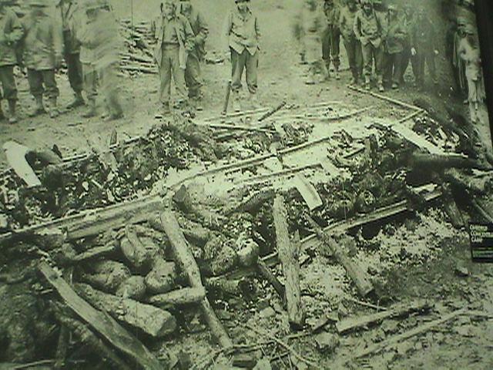
AS YOU EXIT ELEVATOR
YOU COME FACE TO FACE WITH THE HORROR OF THIS EVENT

Slide 55
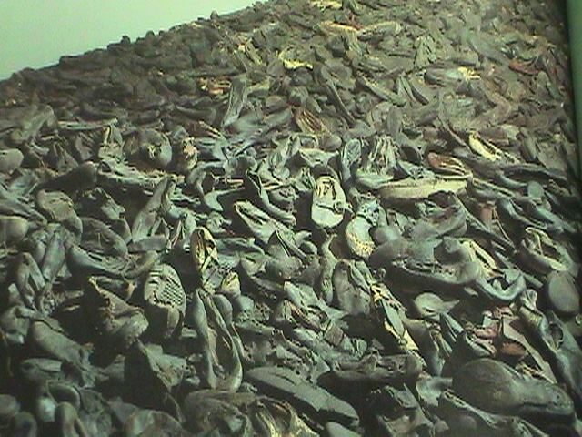
THE SHOES…

Slide 56
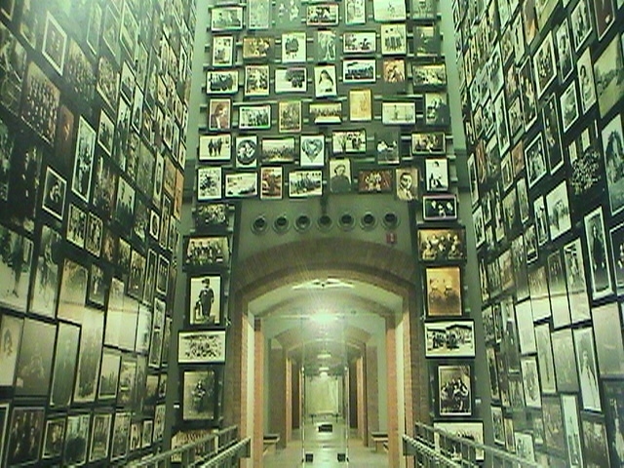
THE VICTIMS

Slide 57
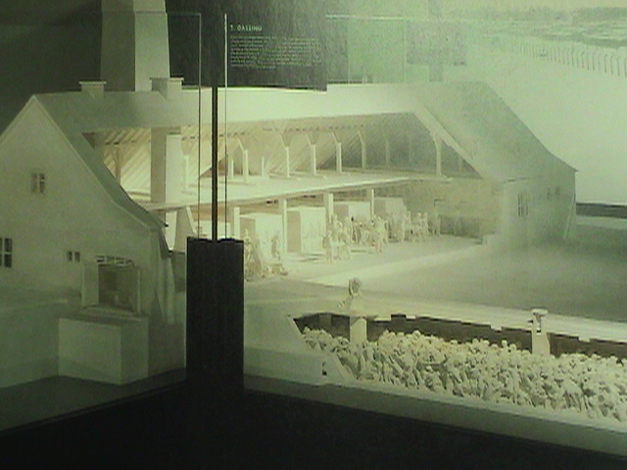
BY THE THOUSANDS…

Slide 58
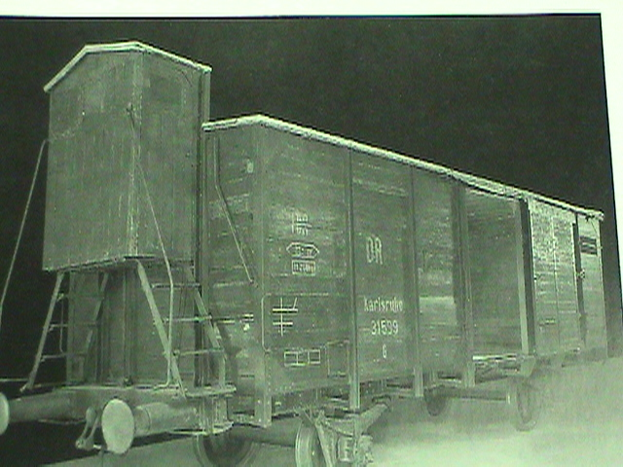
THE TRAIN CAR

Slide 59
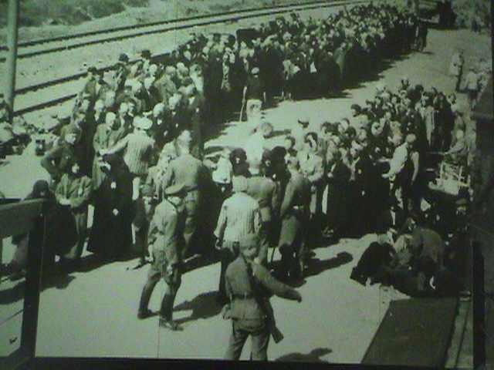
TO THE RIGHT OR THE LEFT
“LIFE OR DEATH”

Slide 60
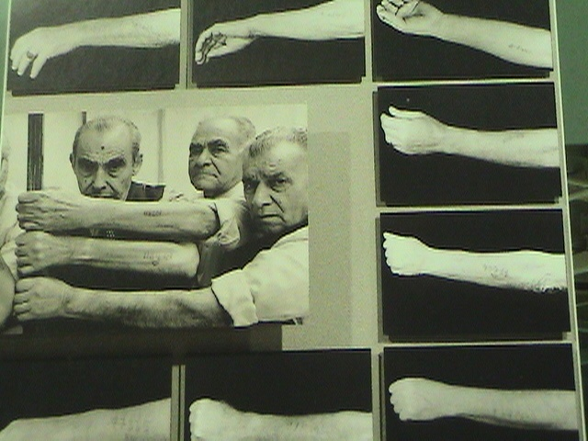
THE ARMS

Slide 61
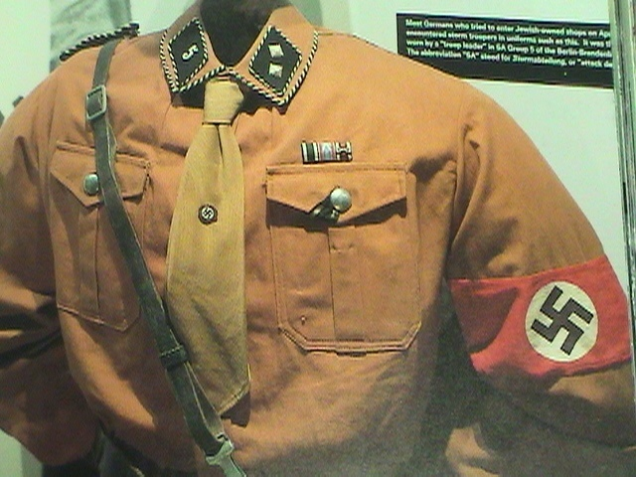
THE UNIFORMS

Slide 62
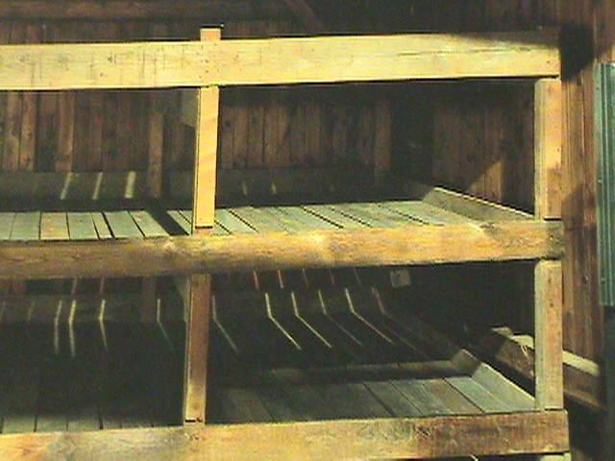
THE BUNKS

Slide 63
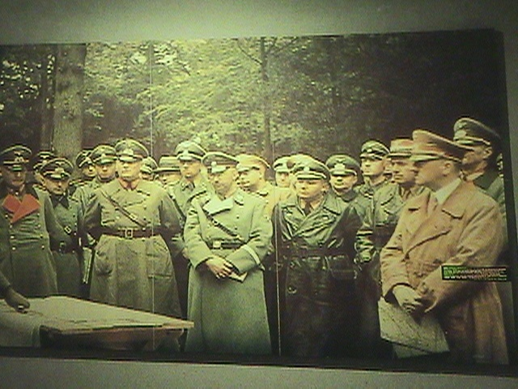
THE FINAL SOLUTION

Slide 64
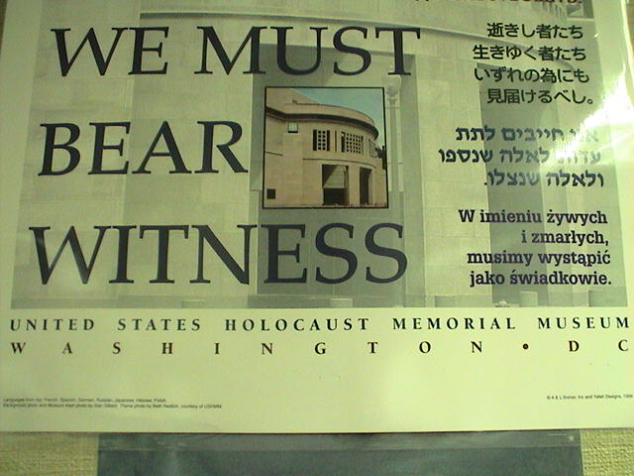
THE HOPE FOR A BETTER FUTURE

Slide 65
HALL OF REMEMBRANCE
AS YOU EXIT MAIN EXHIBIT YOU WILL BE IN HALL OF REMEMBRANCE.
HEXAGONAL STRUCTURE (6 M ) ?
SOLEMN PLACE, REFLECTION
FIRST PARTIAL VIEW OF DC
DIFFUSED SUNLIGHT, SKYLIGHT
ETERNAL FLAME
OFFICIAL US MEMORIAL TO VICTIMS
SENSE OF HOPE AND RENEWAL

Slide 66
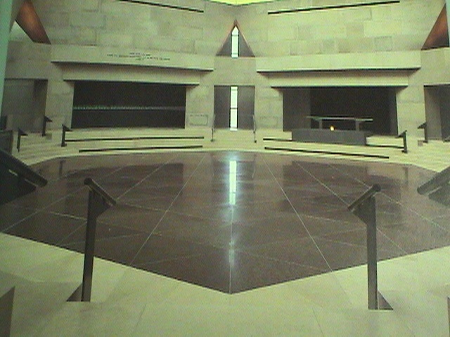
HALL OF REMEMBRANCE
ONCE YOU SEE THIS CAMERA CAN BE USED

Slide 67
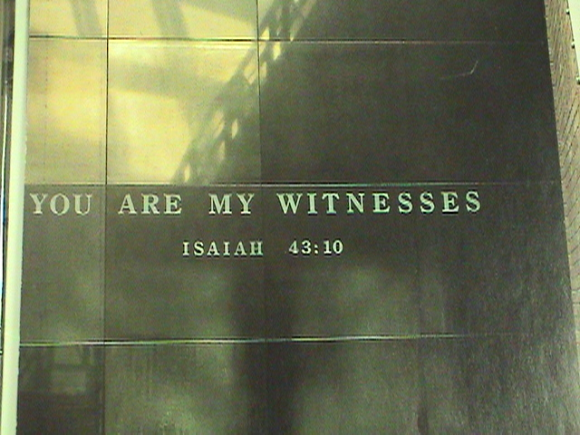
AFTER THIS VISIT, YOU WILL HAVE WITNESSED…

Slide 68
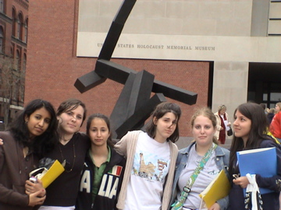
WE WILL MEET OUTSIDE IN THE SAME PLACE WE ENTERED

Slide 69
AS YOU CONCLUDE YOUR VISIT CONSIDER THE FOLLOWING:

Slide 70
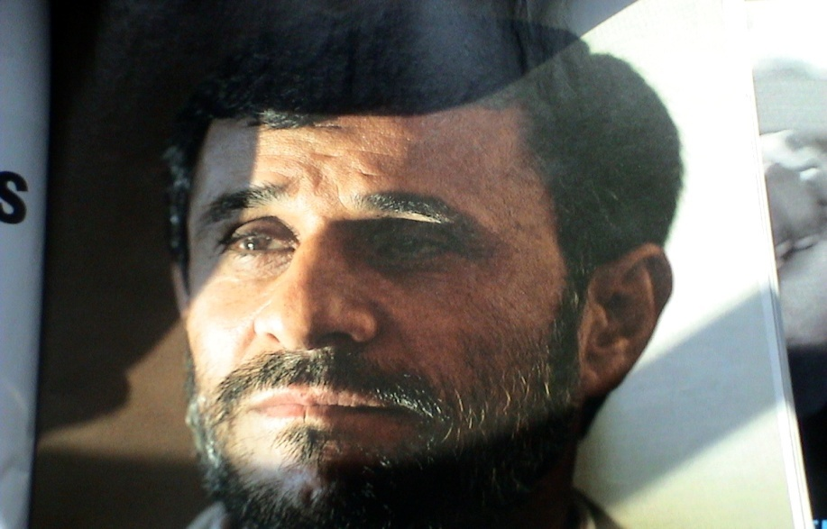
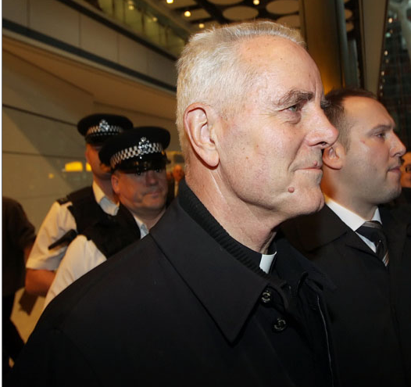
IN SPITE OF OVERWHELMING EVIDENCE TO THE CONTRARY, SOME CONTINUE TO DENY THE HOLOCAUST EVER OCCURRED
FORMER PRESIDENT OF IRAN - NO HOLOCAUST
BISHOP WILLIAMSON - NO GAS CHAMBERS

Slide 71
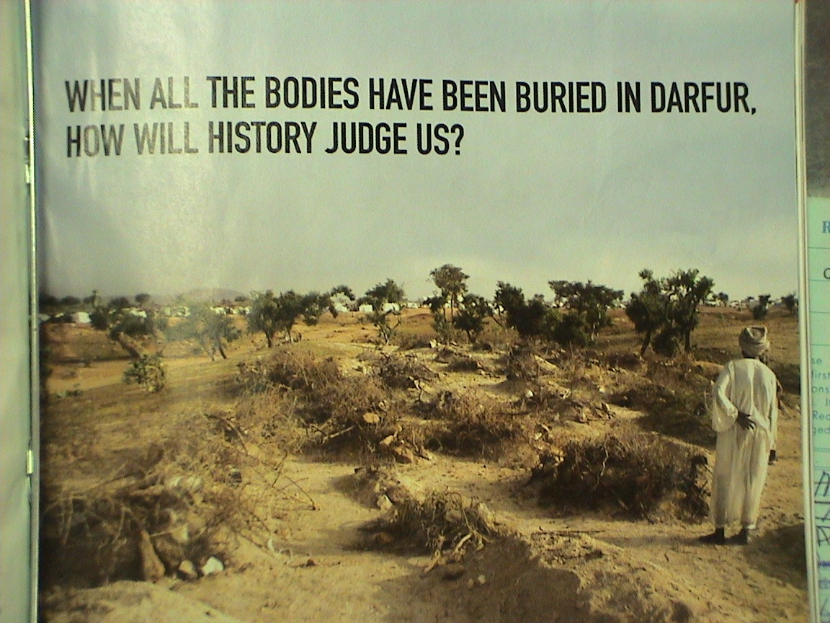
IN SPITE OF CRIES OF
“NEVER AGAIN”
IT HAPPENS AGAIN

Slide 72

PERHAPS THIS DAY WILL INSPIRE YOU TO TAKE ACTION

Slide 73
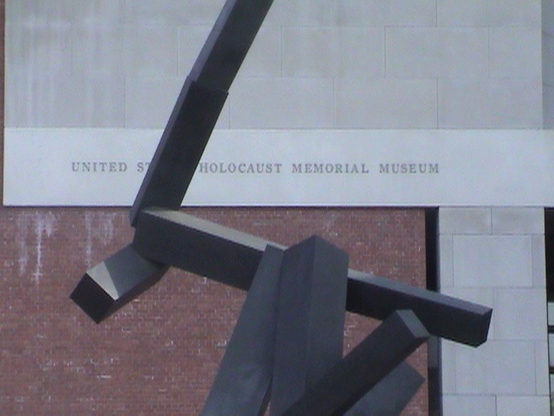
IT WAS FOR THIS REASON THE HOLOCAUST MEMORIAL WAS BUILT

Slide 74

THIS TRIP IS DESIGNED TO EDUCATE YOU

Slide 75

TO ENCOURAGE YOU TO MAKE DEMANDS OF
“NEVER AGAIN”

Slide 76

UNDERSTAND THAT BETWEEN THE TIME WE DEPART MCDOWELL AND THE TIME WE RETURN, PEOPLE IN DARFUR WILL DIE AS A RESULT OF GENOCIDE!

Slide 77

MY HOPE IS THAT THIS DAY WILL INSPIRE YOU TO DO YOUR PART

Slide 78
THIS TRIP INVOLVES THE TEACHING OF SOME POWERFUL LESSONS.
IT IS OUR HOPE YOU LEARN FROM THOSE LESSONS.

Slide 79
THIS DAY WILL PROVE DIFFICULT IN BOTH A PHYSICAL AND EMOTIONAL SENSE.
YOU ARE TO BE COMMENDED FOR MAKING THIS EFFORT!!

Slide 80
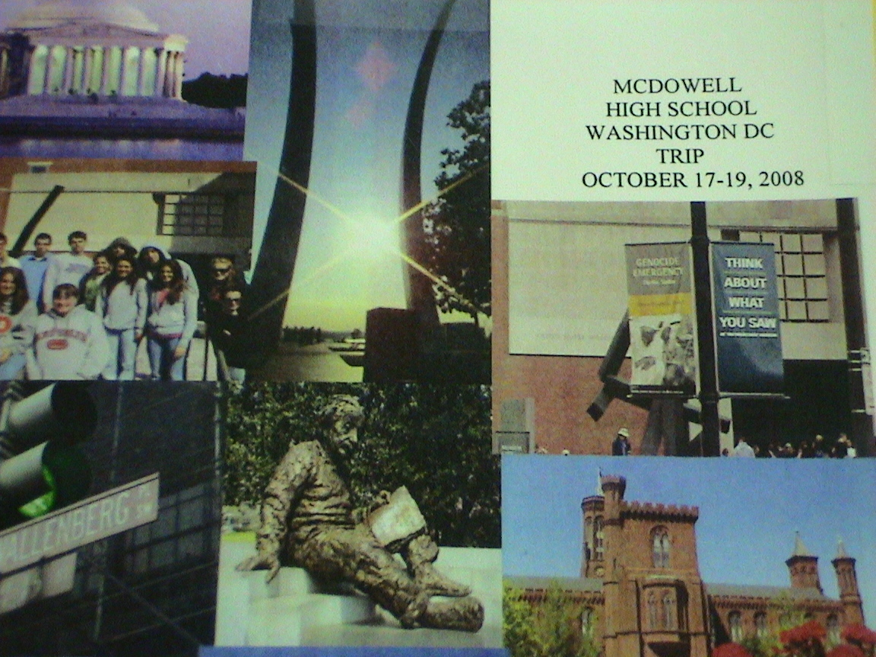
IF YOU WANT TO SEE MORE - WE DO TRAVEL TO DC IN OCTOBER FOR A
3 DAY TRIP
SEE ME FOR INFO ON THAT

Slide 81
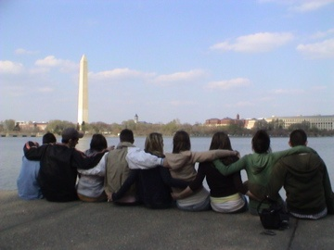
I THANK YOU FOR BEING HERE TODAY AND LOOK FORWARD TO TRAVELING WITH YOU

Slide 82
IF YOU HAVE ANY QUESTIONS PLEASE LET ME KNOW!
THANK YOU FOR YOUR TIME AND ATTENTION.

